Slide 1
JONAS CALAYCAY

Slide 2
Stories Behind The Year-end Party Entries of Embedded Section and How Are They Created

Slide 3
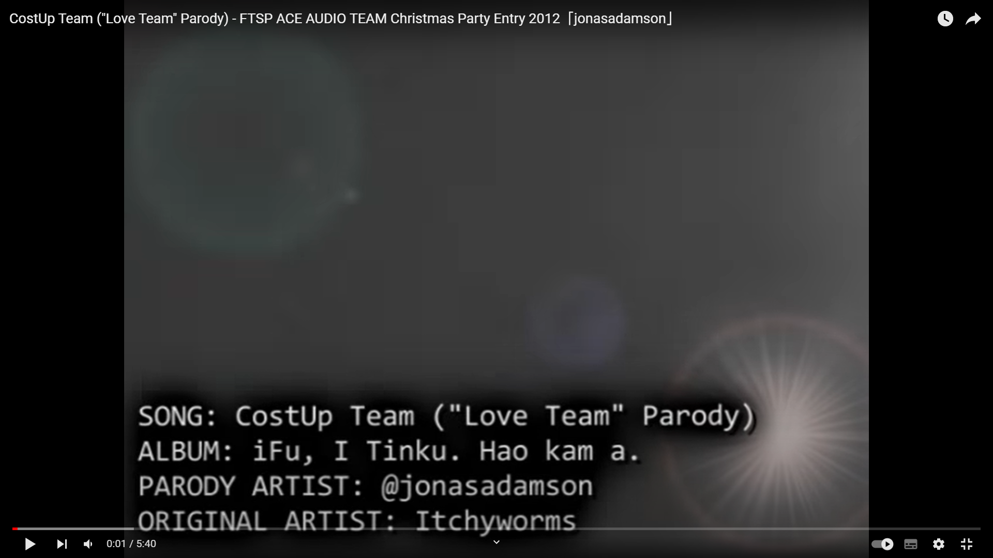

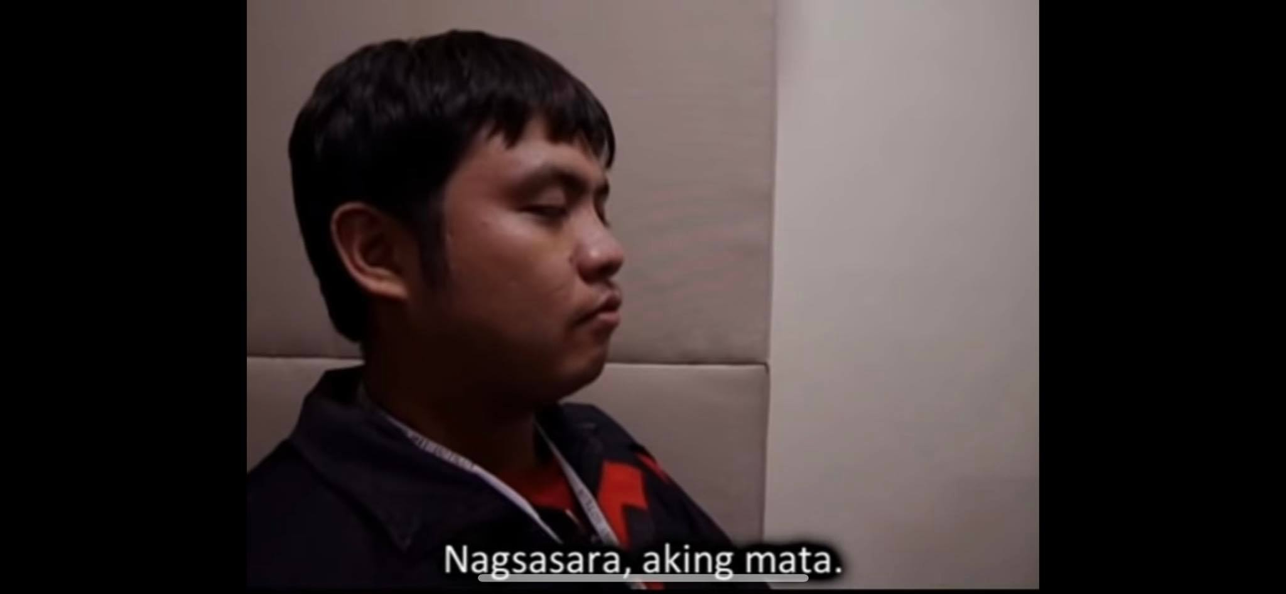
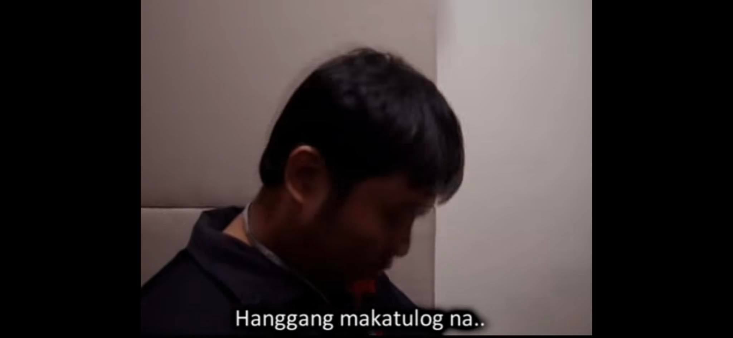
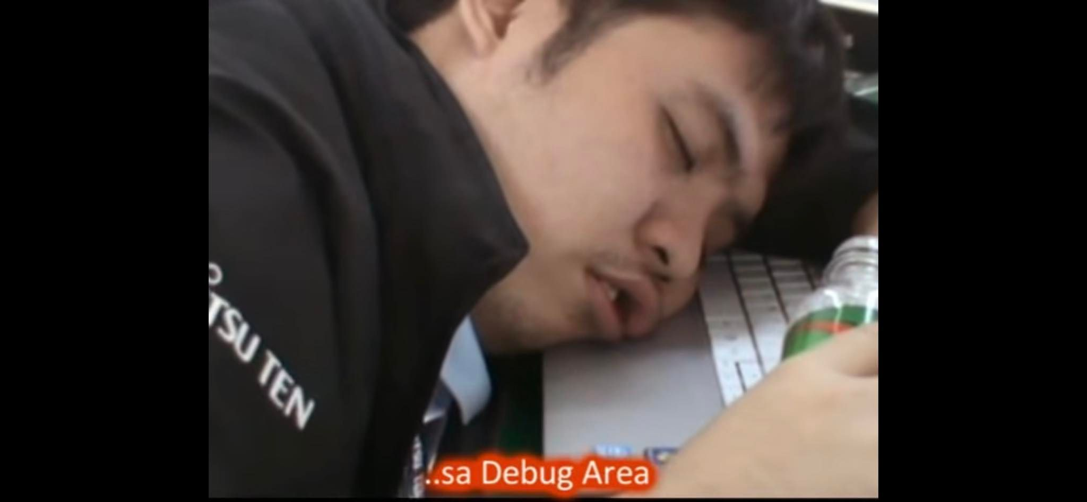
Music Video Contest: Year End Party 2012
Notes:
Istorya ng isang developer na naghahabol ng item for submission. Umasa sya na magkasinghaba yung deadline at oras ng estimate nya… unfortunately, hindi.
Ang tanging pag asa nya ay mag overtime hanggng Linggo. Pero meron syang lihim na gusto. Gusto nya mag leave na mula ngayon hanggng sa Linggo.
Overtime, Some overnights – Still learning the ACE Platform
Coffee, Energy drinks to keep us alert and awake.

Slide 4
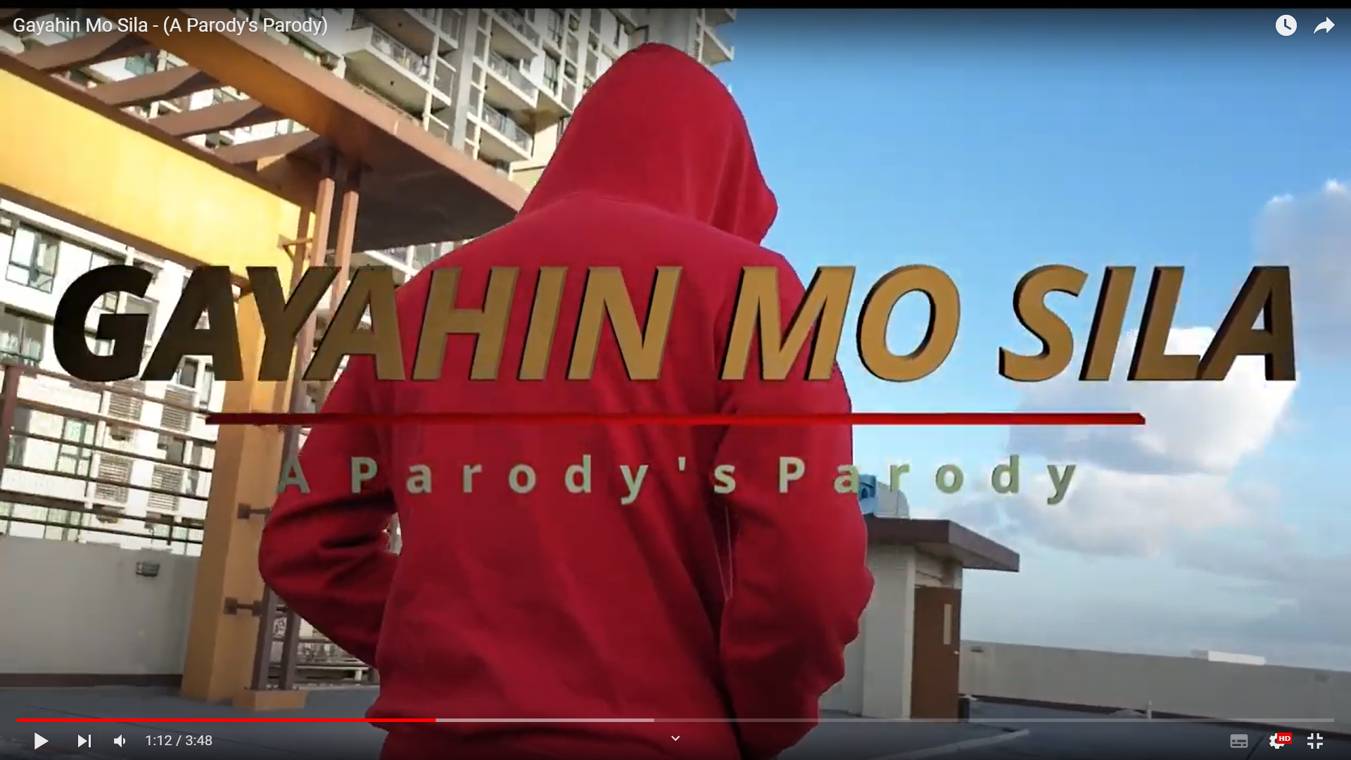
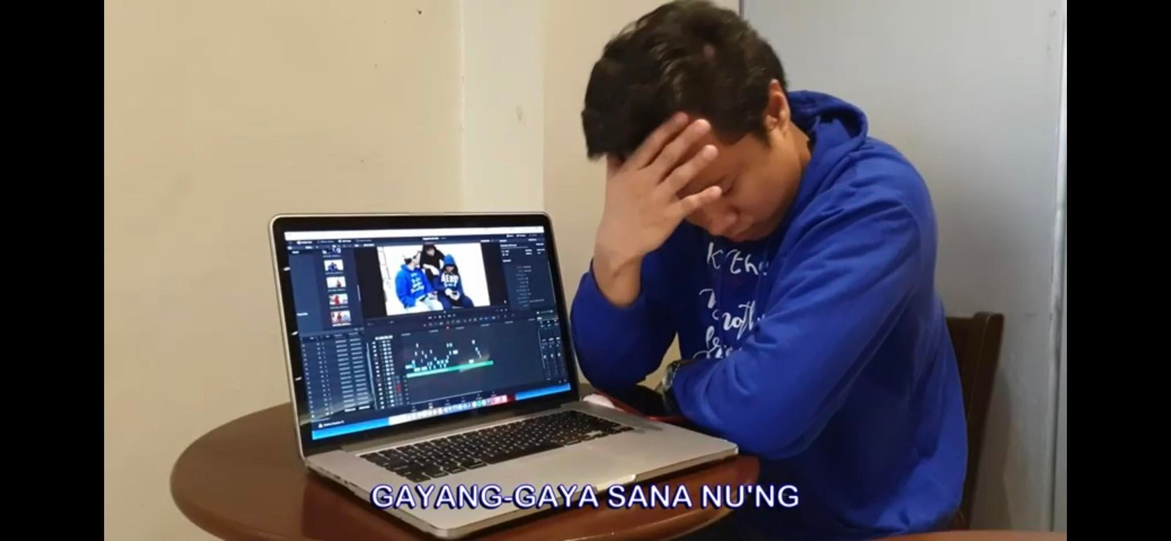
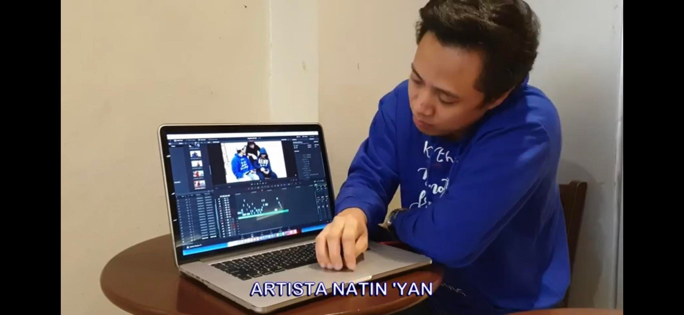
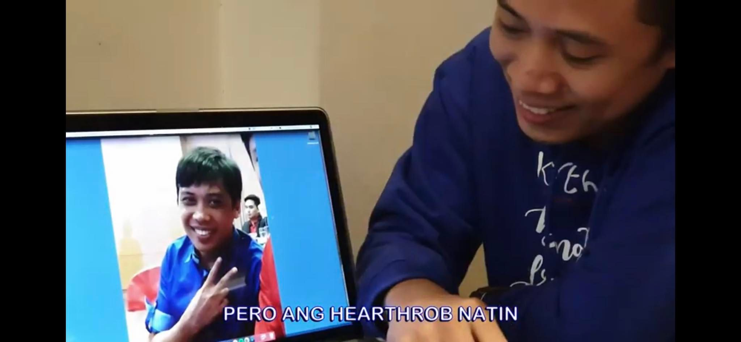
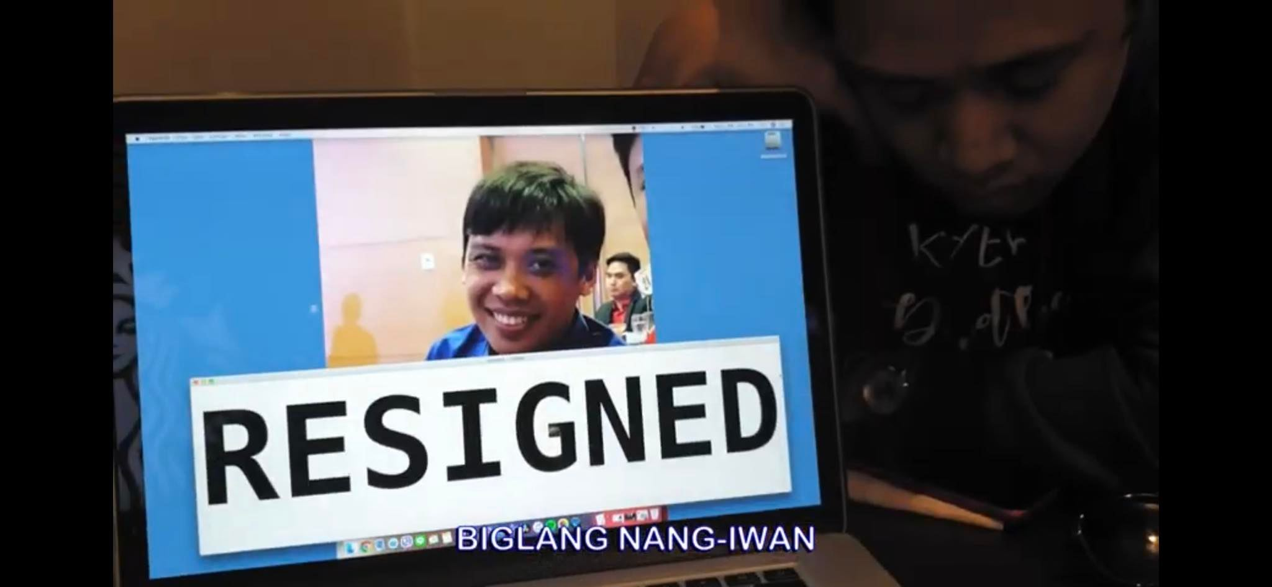
Viral Video Contest: Year End Party 2018
Notes:
Viral Video Contest. Embedded wala pang entry. Nagkacram na sa pagconceptualize kung anong viral video ang gagawin.
Unang naisip ay gayahin yung isang bubble gang short clip na Bubble Gang: Lalaki, hinuli ng pulis dahil sobrang feeling
Bagay sana maging main actor si Ryu, kaso resigned na sya.
Pressured na magcreate ng entry, pero no more enough time to conceptualize.
Para Madali, hanap nalang sa fb, youtube or any trending.
Ni-remake namin yung parody at nilagay na istorya yung mismong struggles namin sa pagconceptualize at paggawa ng Viral Video Entry ng embedded.

Slide 5
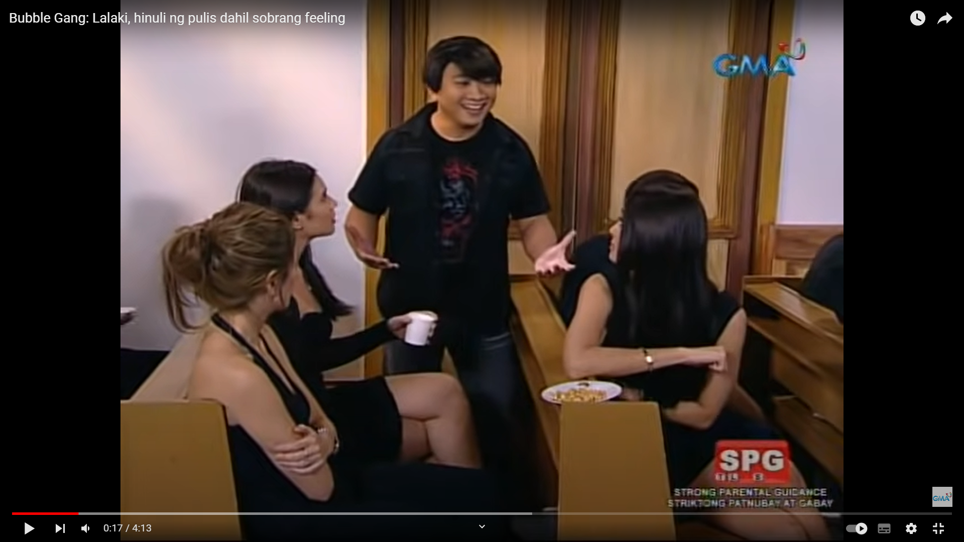

Slide 6
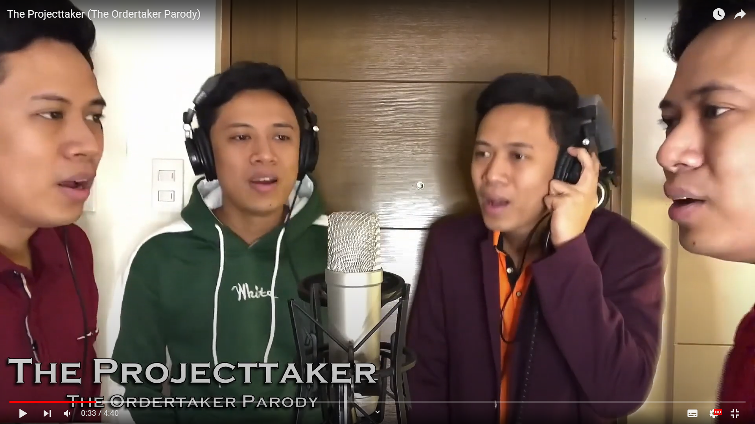
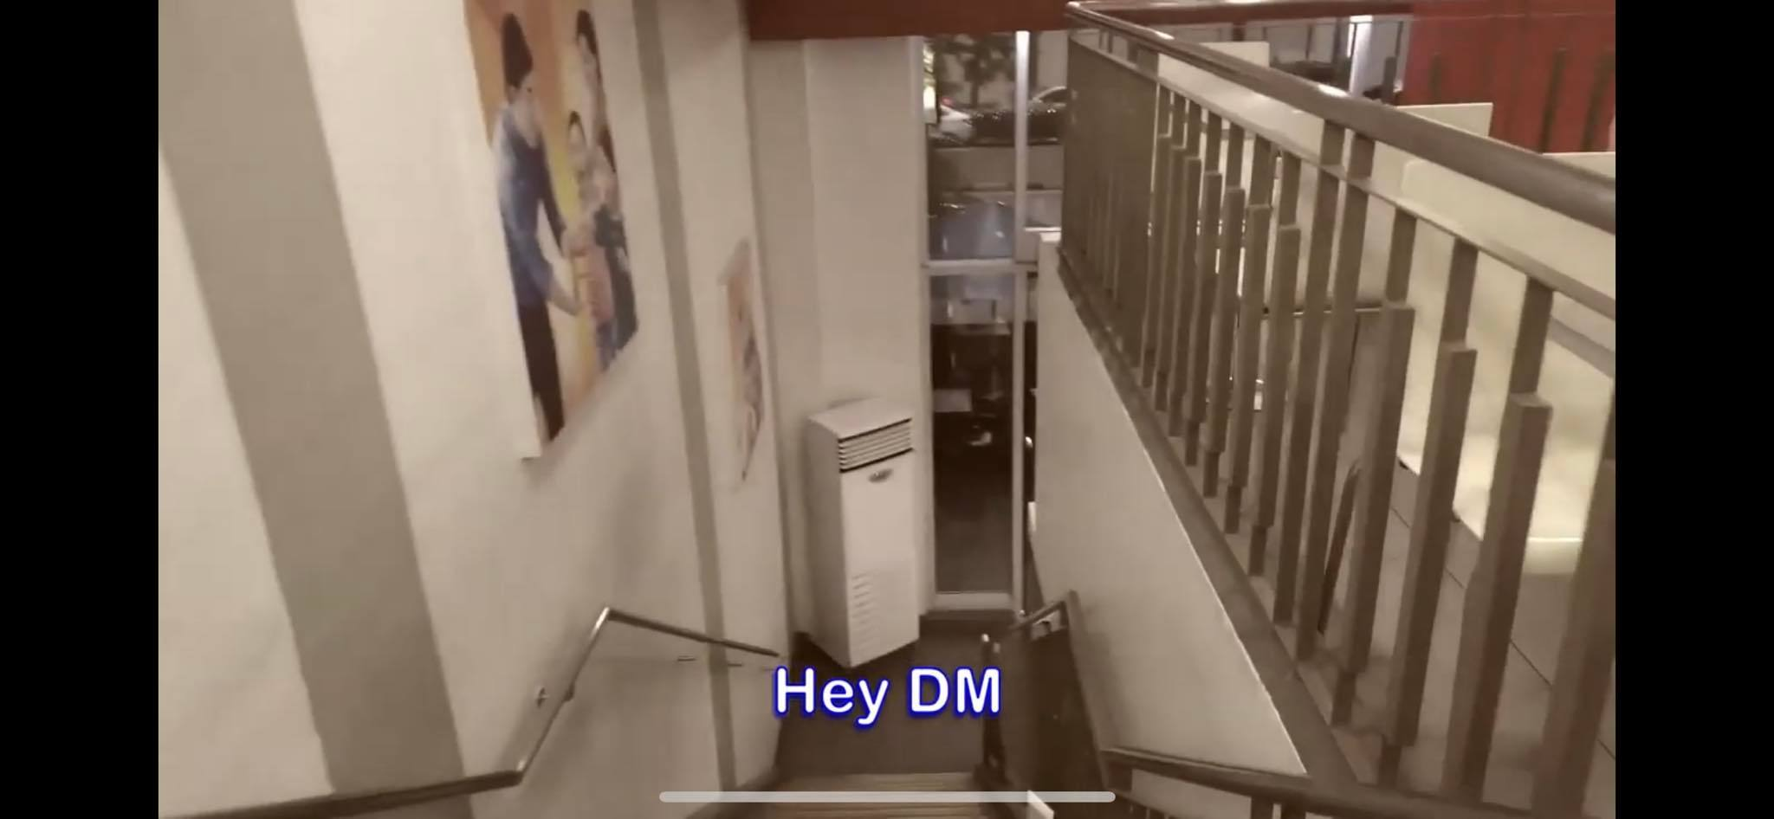
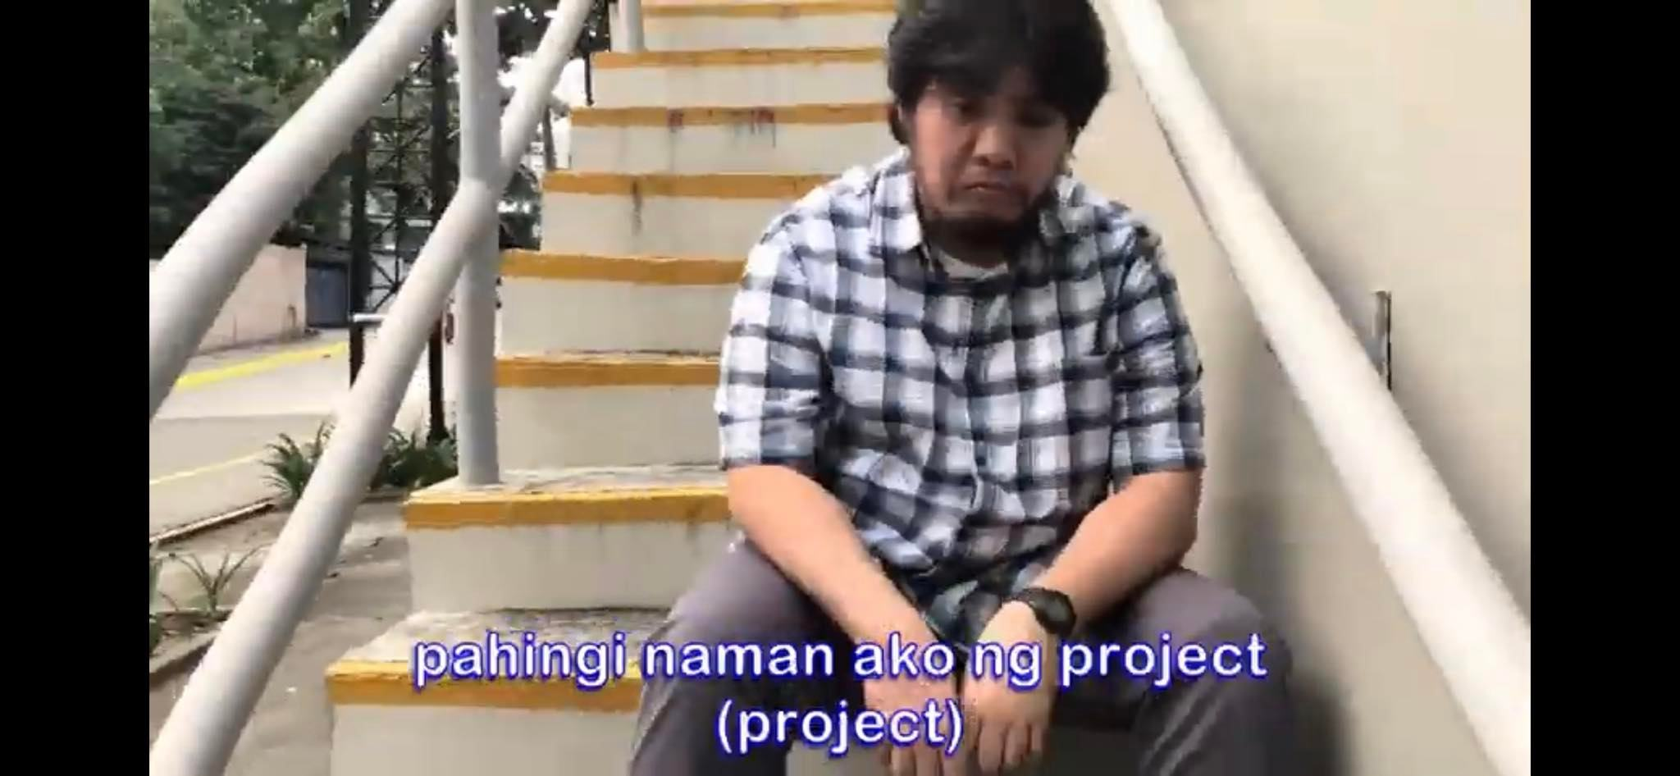
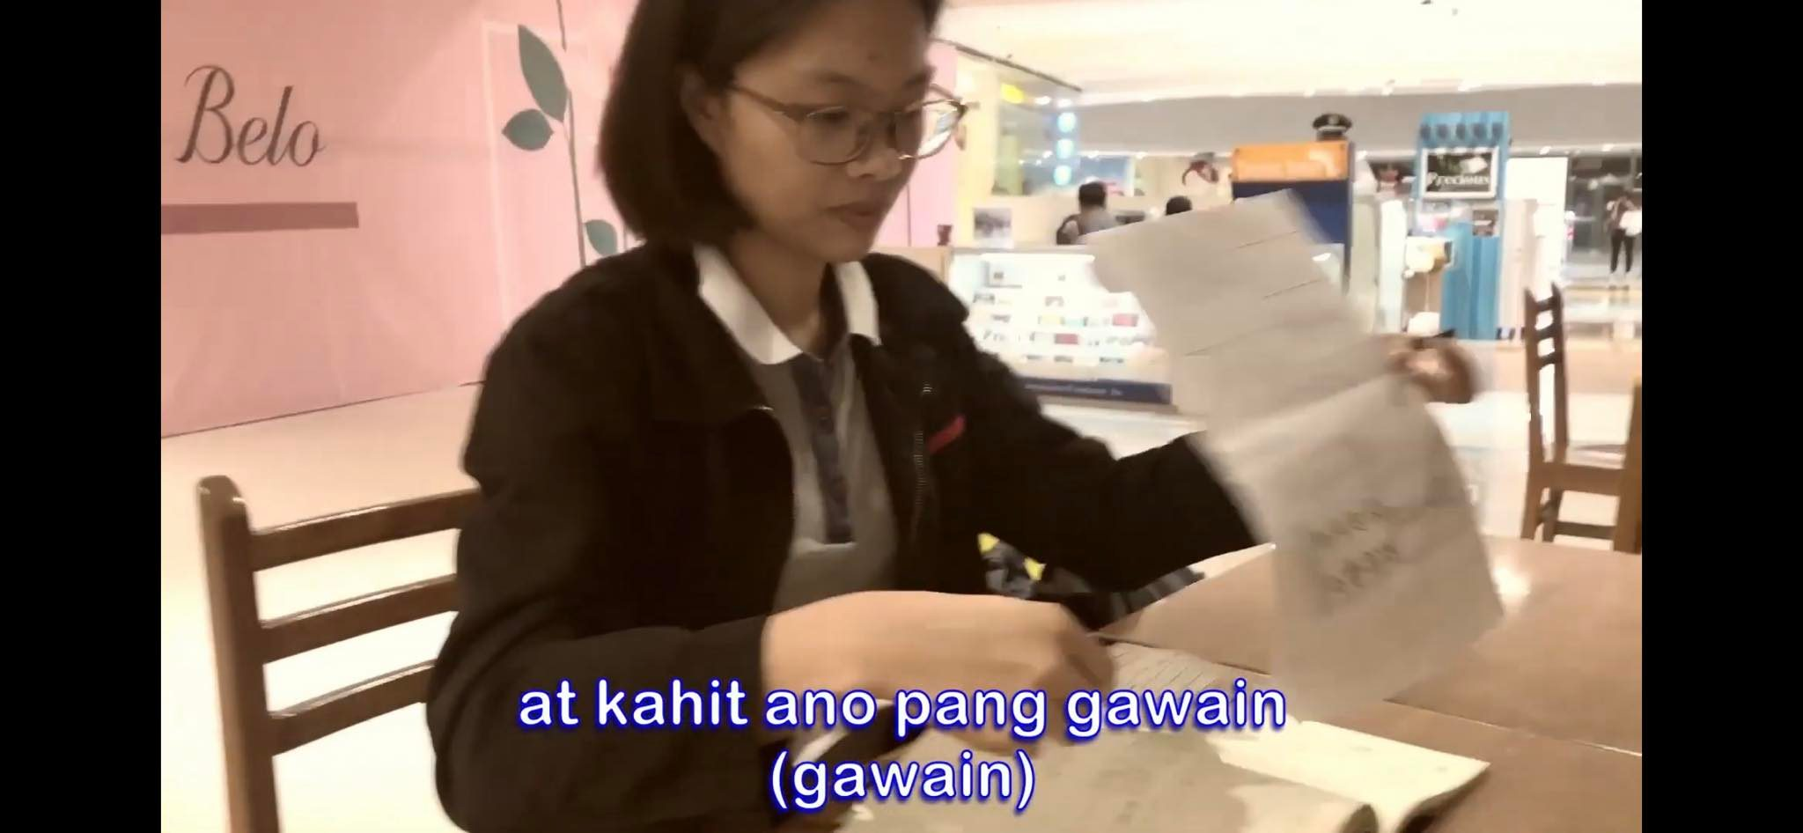
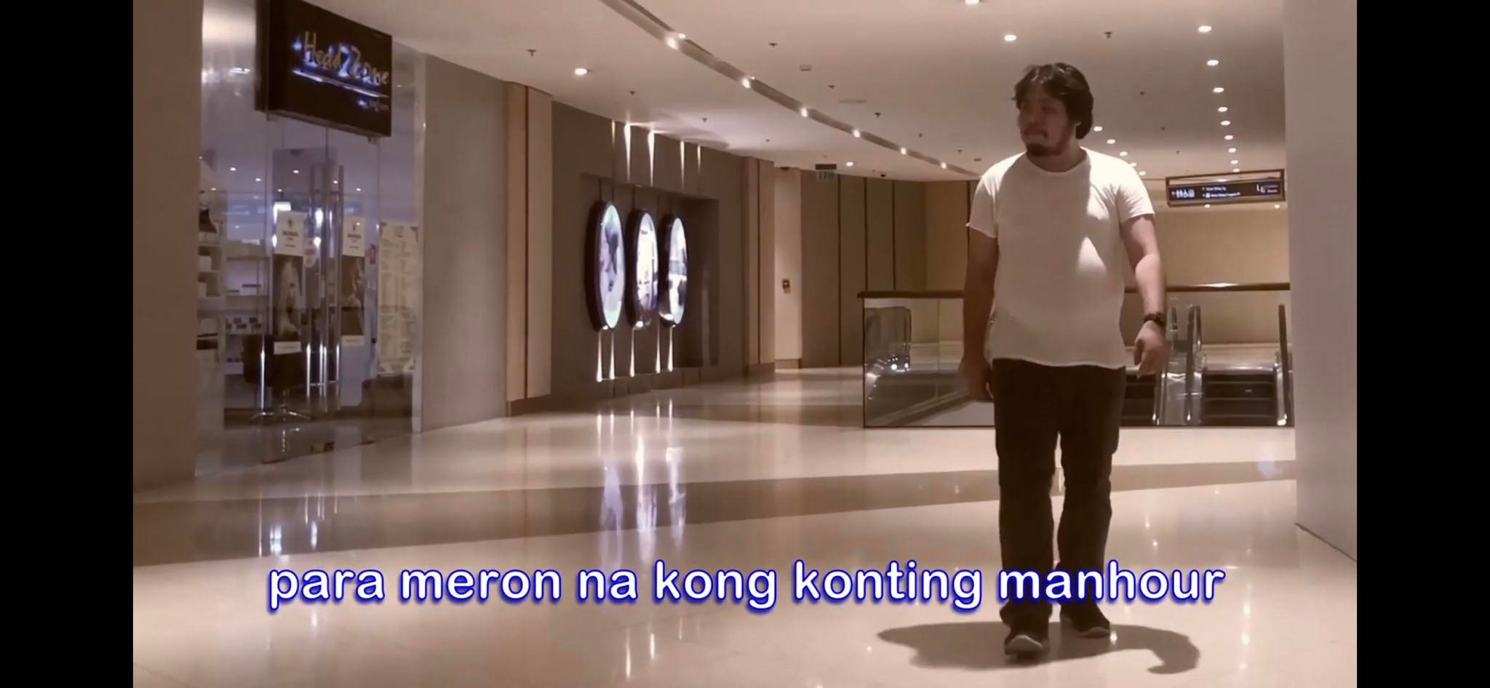
Music Video Contest: Year End Party 2019
Notes:
Music Video Contest 2019: Year-end Party 2019
Idea: parody of The ordertaker by PnE. But, with a twist. Tune is changed to Doo Wop Wop Wop version.
Song: About the struggles of having no project at that time.
Hingi ng any activity tulad ng sabi sa lyrics
Meron ba tayong project? Wala na po
Meron ba tayong revisions? Wala na rin po
Meron ba tayong testing? Ubos na po
Meron ba tayong kahit na ano..
Dahil walang project, hoping yung composer na sana di sya malipat sa ibang dept..
Each person in the video represents a project, other companies, Some departments.

Slide 7
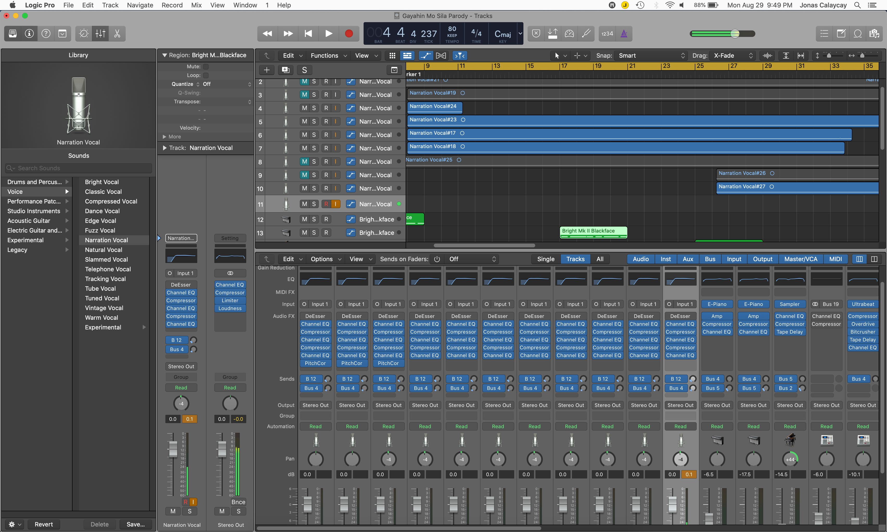

Slide 8
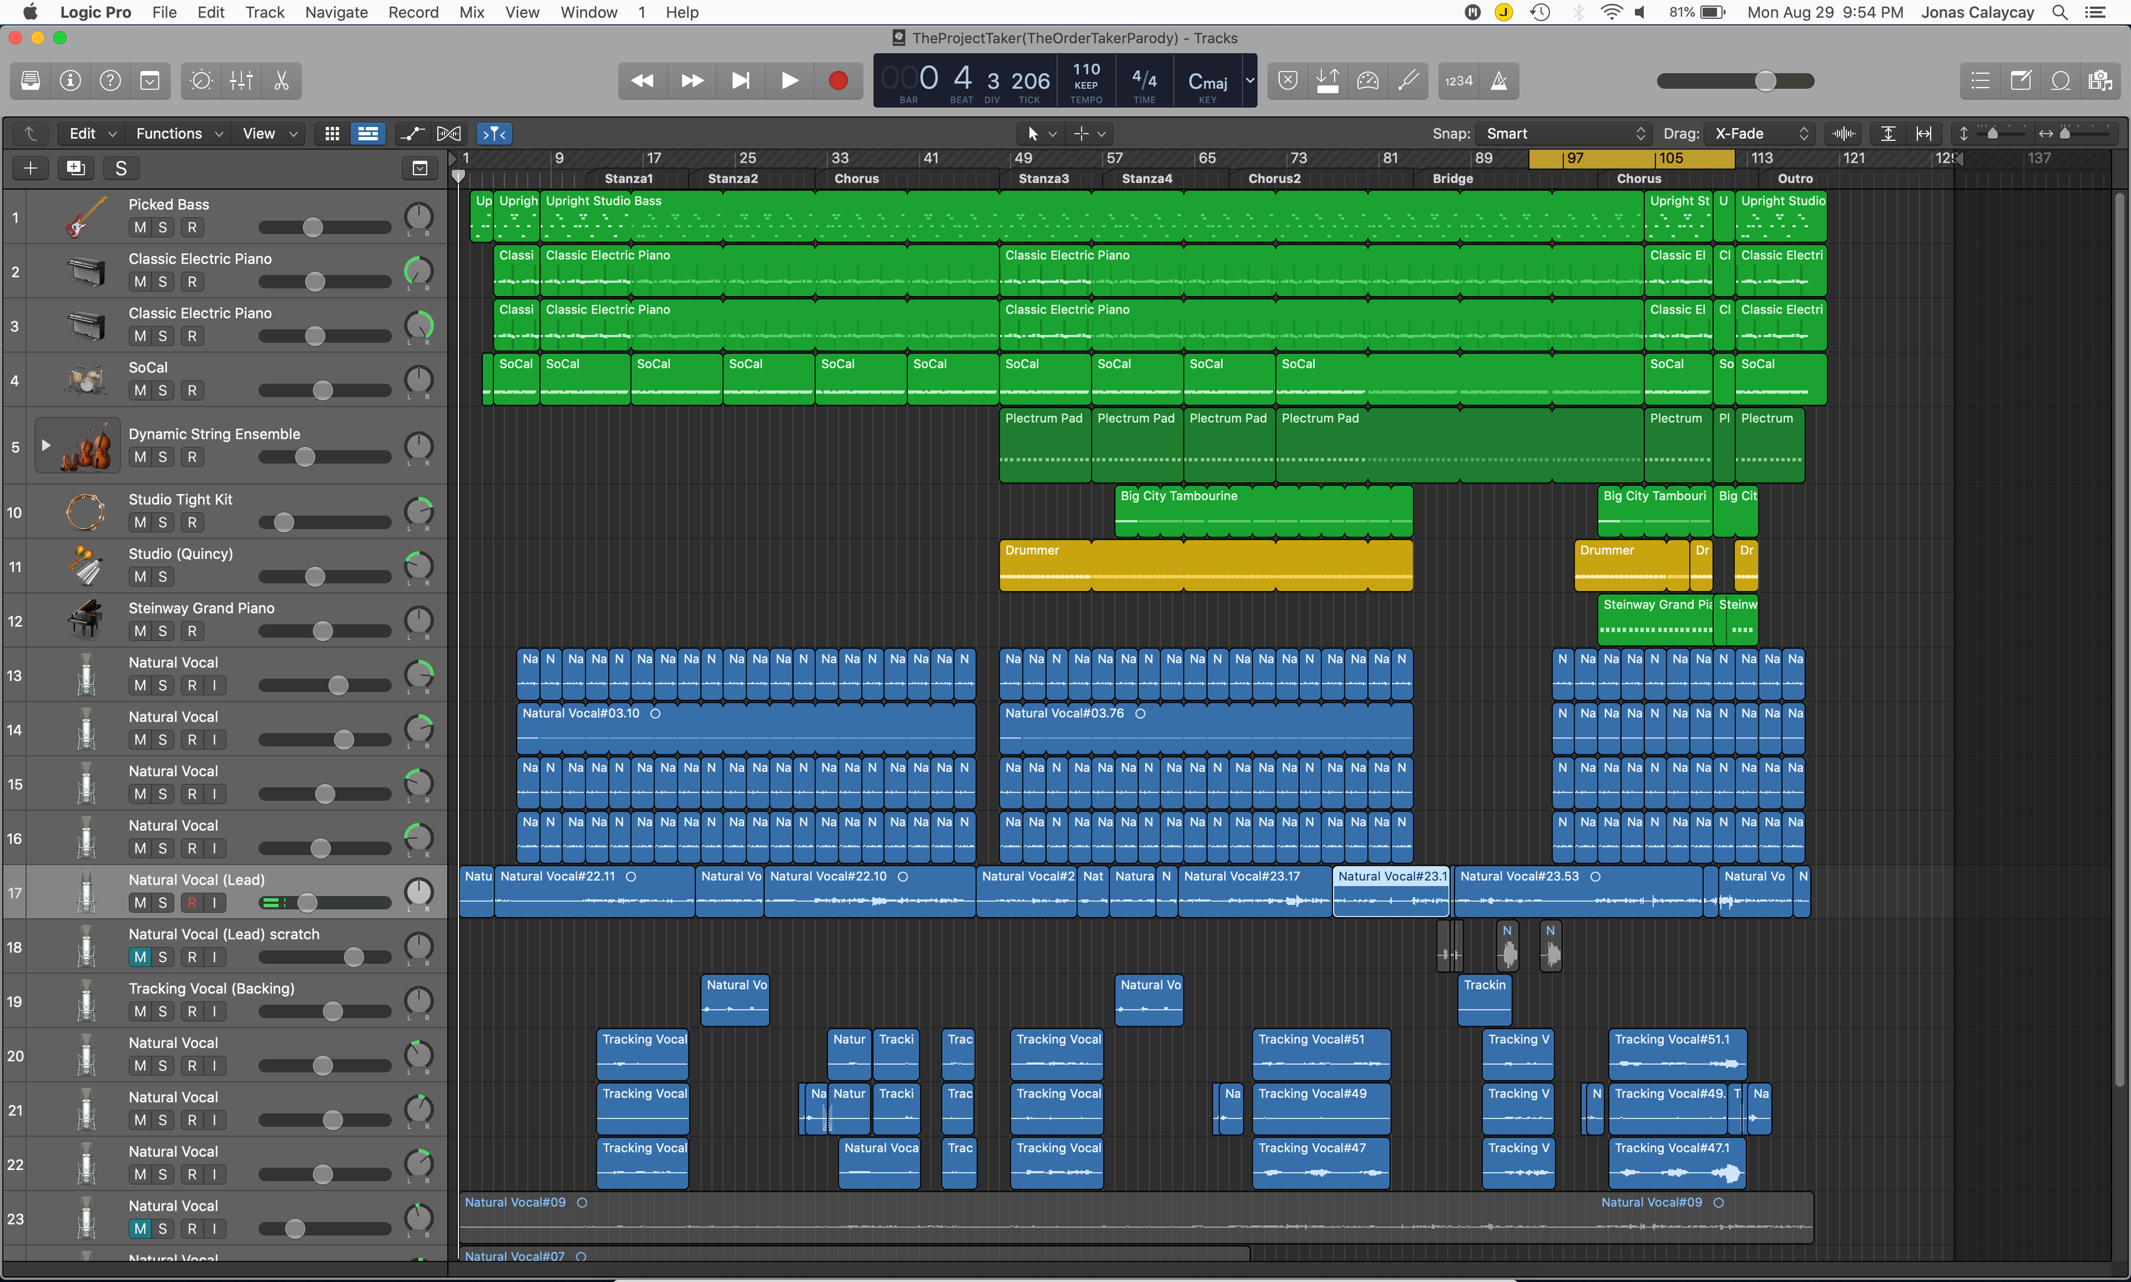

Slide 9
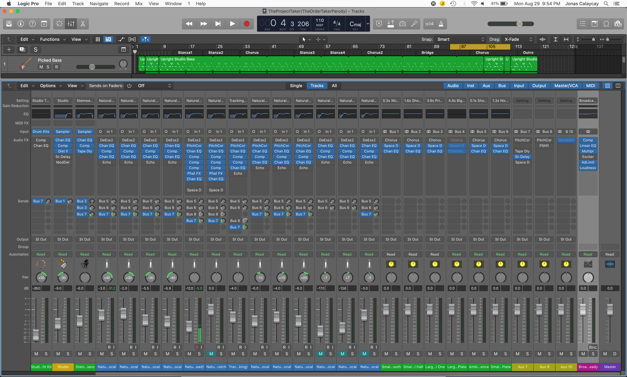

Slide 10
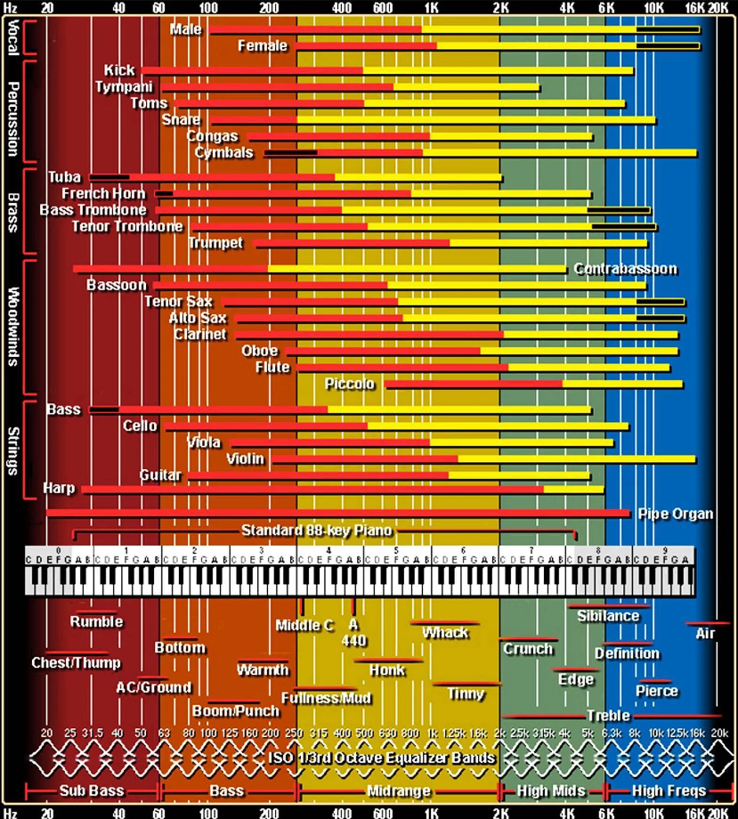
Notes:
Fullness, Boominess, Presence, Sibilance

Slide 11
ENJOYABLE
EASIEST
MOST DIFFICULT
DISLIKE
Notes:
Enjoyable: Mixing
Easiest: Recording Rhythm Guitars
Most Difficult: To listen by parts and actual recording
Most Dislike: Pagkapa ng lead guitars and strings (violin, Viola, bajo de arko,

